Slide 1
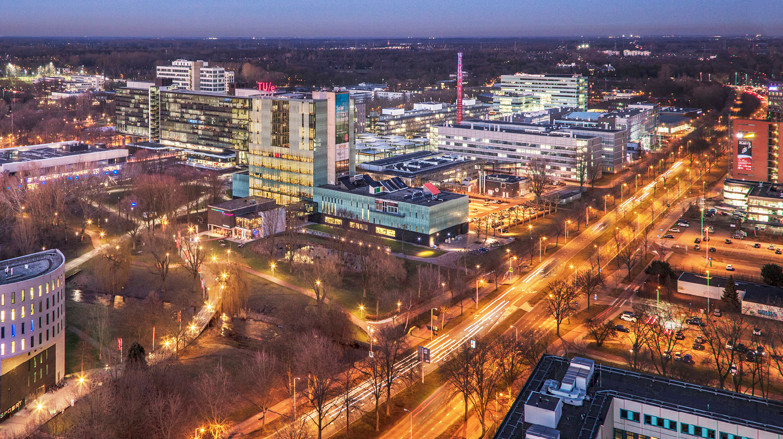
2022 AutoRef – Meeting III
03 March 2023
Elham Honarvar, Project Manager, PDEng Trainee MSD 2022
1
2022 MSD AutoRef Project
1

Slide 2
Summary
Progress of the project
Reviewing Needs
General Requirements
Scope of the project
System thinking
Detailed Requirements
Possible Challenges
2022 MSD AutoRef Project

Slide 3
Project Timeline
 | Week |  |  |  |  |  | Final week
Project activities schedule | 1 | 2 | 3 | 4 | 5 | 6 | 7
 | 06/02-13/02 | 13/02-19/02 | 20/02-26/02 | 27/02-05/03 | 06/03-12/03 | 13/03-19/03 | 20/03-24/03
Project Management Plan creation |  |  | Final version
2021-2022 MSD project documents review
Hardware and software options evaluation
Project scope definition
New requirements creation
Feasibility Check of input data
Detailed Requirements and System Architecture
Software creation and integration
Systems test
Documentations and main delivarables |  |  |  |  |  |  | Final Presentation
Weekly meeting with stakeholders
2022 MSD AutoRef Project

Slide 4
Needs and Expectations
The AutoRef should conduct a 5 mins match with 2 vs 2
The AutoRef should be fair about the decisions it made
The AutoRef should reliable, work in different stadiums, independent of area of gameplay and time of game
A final delivery should match with the team limited resources
Proper documentation should be provided
Personal learning goals of the team members should be achieved
The system should have logs of the match and can show evidence of violations when needed
The system can communicate with the human referee, have feedback, and assist during the match
The project should build on the work of the previous years
The project should allow the next generation to work on top of this year's results
2022 MSD AutoRef Project

Slide 5
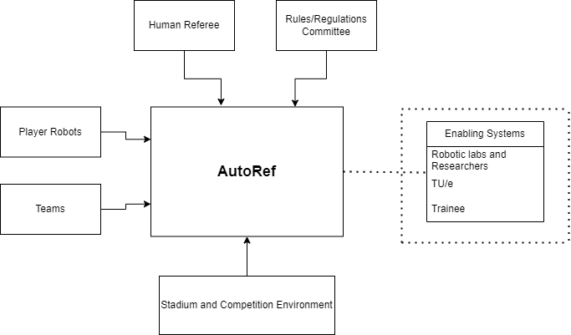
External System and Enabling Systems
External Systems are defined as the related parties with the AutoRef while it is working such as players and teams during a match etc.
Enabling Systems are defined as the people or organizations that are indirectly related but have mutual interests with the system.

Slide 6
Mission
Pre-mission | Mission | Post-Mission
System mounting to environment | Check the kick-off procedure | Ensure and handle the data related to the game is safe
Communication with related parties before match (Refbox etc.) | Set time and start the match | Shut Down the system
Turn on the system | Monitor the whole match and game states
 | Record the last position of ball in case of connection with field line
 | Detect rule violation
 | Decision-making algorithm (award and punishment system such as penalty or yellow card)
 | Help human referee if needed
 | Log and show evidence for game calls
 | Stop the game when needed and check procedures before starting again.
 | End match
2022 MSD AutoRef Project

Slide 7
Functional Requirements
AutoRef shall be aware of the time and use this information to start and stop the match.
AutoRef shall comply with MSL Rulebook while deciding violations and following procedures
AutoRef shall decide an award or punishment regarding the violations and procedures during the match
AutoRef shall gather data and can comprehend its reliability
AutoRef can estimate game states by using data gathered during the match
The game states can be listed as follows:
Fixed coordinate system shall be defined originated from one of the corners of the field that have two perpendicular axes
The positions and velocities of soccer robots for each delta-T relative to the coordinate system.
Positions of the lines and specific areas in the field relative to the coordinate system.
The field line position the ball has touched last.
The time elapsed between the first and last touch of the robot during dribbling.
The position and velocity of the ball.
2022 MSD AutoRef Project

Slide 8
Performance Requirements
All hardware regarding the AutoRef shall be compatible with MSL organization environment.
AutoRef shall give permission to users to modify pre-defined game rule parameters and/or deploy some/all the rules.
AutoRef shall be connected to Refbox via TBD with maximum TBD latency.
AutoRef shall be capable of sending/receiving digital ON/OFF signals to/from AutoRef.
AutoRef shall record/store game data as well as log history.
AutoRef shall allow users to use stored data and download it.
AutoRef shall upload game data automatically a TBD deposit and ensure its safety during the process.
AutoRef shall create a virtual coordinate system that overlaps with field lines originating from corner spot.
AutoRef shall acquire data in each TBD second and estimate game states max TBD cm for positions and TBD cm/s for velocities relative to the field line coordinate system.
AutoRef shall decide a violation within TBD seconds.

Slide 9
Main Requirement
Detect any violation occurring when starting the game with a corner kick within 1 sec with 85% accuracy (true detections)
The game states that needs to be detected are:
Fixed coordinate system shall be defined originated from one of the corners of the field that have two perpendicular axes
The positions of soccer robots for each delta-T (sampling time TBD) relative to the coordinate system
Positions of the lines that defines the field relative to the coordinate system
The position of the ball

Slide 10
Feasibility Analysis
Deliverables:
Individual reports containing the feasibility analysis of each technology
Design Feasibility Analysis:
Sensors Mounted on top of each player
Using Data Fusion for Data Collection
Using Tech United Data
Using Stadium Cameras
2022 MSD AutoRef Project

Slide 11
Sensors Mounted on top of each player
Because of time and resource limitations, we can't design any hardware and integrate it on the robots
Advantages:
Trustable and reliable data source
Comprehensive (Full view of field)
Available cameras
Easy to record and re-use
Could be built upon in the future generations
Contribution of other teams is possible
Disadvantage:
Design a mounting device for the camera
Expensive Solution
Might involve additional regulation on players (Hardware constraints)
Processing time for decision making
Processing work
Fusion of more than one camera for a better field understanding
2022 MSD AutoRef Project

Slide 12
Using Data Fusion for data collection
Choose almost any rule, not real time for our scope, no theoretical knowledge nor ready to use implementation
Advantage
Easy to use
Data available from both teams
Easy to record and re-use
Could be built upon in the future generations
Use advanced technologies in the future with no additional cost for referee
Disadvantage
Possibility of misleading data due to cheating
Possibility of not having all field covered
Additional verification and validation may be required
2022 MSD AutoRef Project

Slide 13
Using Tech United Data as a Preliminary Data Source
Any rule can be applied, Provides real-time data for our scoop, Extra rules need to be added.
Advantage:
All data which is needed for rule violation detection is available and can be used to prepare an algorithm for referee decision making.
The state of the game has been announced from inside the game and this can give a chance of having accurate data.
Reliable hardware and software are available (copy from last year's report).
Real robot soccer can be represented.
Disadvantage (this is based on the information of last year research):
The data can be unreliable due to noise since localization during robot movement is distorted and the field is highly symmetrical.
The position of the ball has been estimated by several sources and the new designed algorithm needs to merge all the information.
2022 MSD AutoRef Project

Slide 14
Feasibility Analysis
Why stadium cameras?
Choose one rule such as corner kick procedure, not real time for our scope, additional computational solutions may be needed
Advantage
Trustable and reliable data source
Availability – off the shelf
Accessible
Comprehensive data (Full view of field)
Easy to record and re-use
Could be built upon in the future generations
Multi-functioning: Use as an assistant referee and can be further developed
Disadvantage
Processing time for decision making
Processing work
Fusion of more than one camera for a better field understanding
Calibration
2022 MSD AutoRef Project

Slide 15
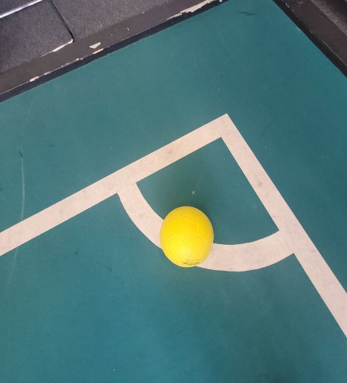
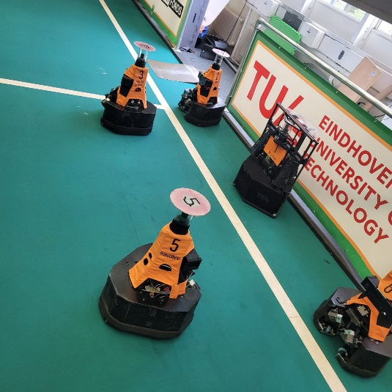
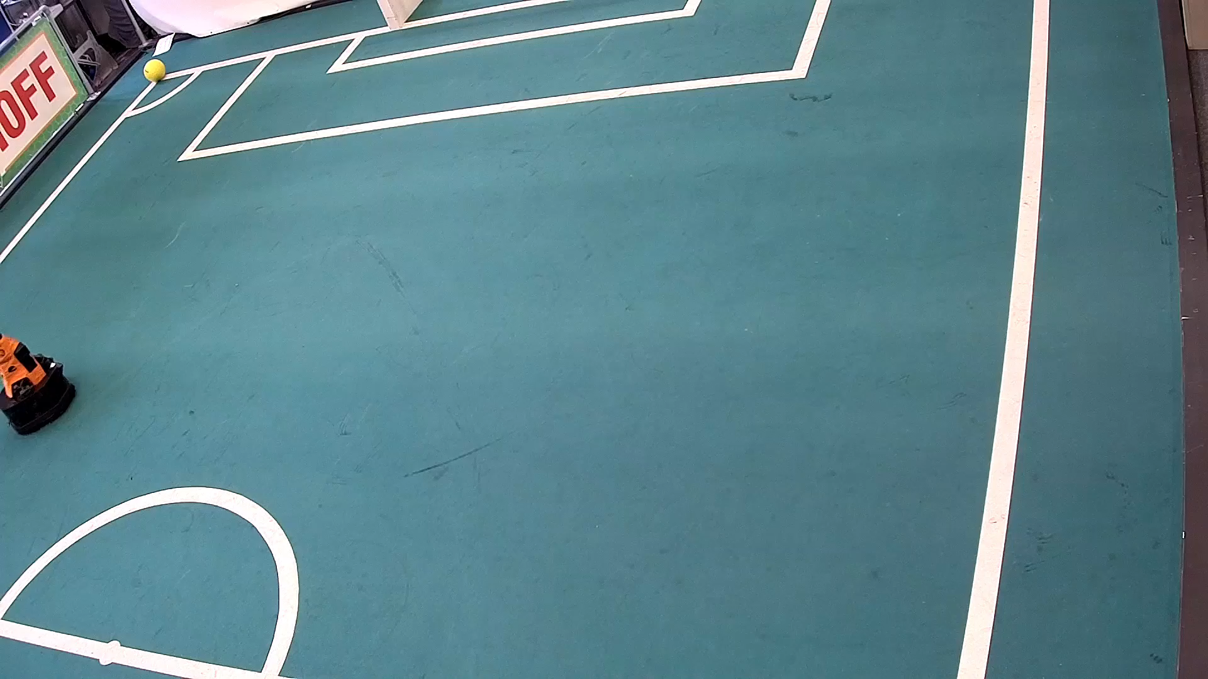
Scope
Use a stationary camera for collecting the data.
Data collection (Videos) of robots and stadium
Analyze different methods for preprocessing the videos and images
Analyze different methods for detecting lines, ball and players
Detect if the rule is violated using a Decision making Algorithm
Log the event
2022 MSD AutoRef Project

Slide 16

Design Challenges
Object detection and tracking
Integration with the stadium infrastructure
Robustness and reliability
Privacy and security
2022 MSD AutoRef Project
Notes:
Object detection and tracking: Robust computer vision algorithms that can handle occlusions, changes in lighting conditions, and cluttered backgrounds.
Rule-based decision making: Designing an intelligent system that can process multiple inputs and apply complex decision-making algorithms to determine if a violation has occurred.
Communication with the robots: Designing a communication protocol that enables the robots to receive commands and respond to them in real-time.
Integration with the stadium infrastructure: cameras, lighting, and sound systems.
Human-machine interaction: The autonomous referee must be designed to interact with human referees and players
Robustness and reliability: to handle the challenging conditions of a soccer game. This includes dealing with the unpredictable behavior of the robots, changes in lighting conditions, and potential interference from other devices.
Privacy and security: not vulnerable to hacking or other cyber threats.

Slide 17
Questions
2022 MSD AutoRef Project

Slide 18
Data available
Robot position, ball position, team status (attacking/defending) or who passed the ball last.
fieldAreaCoords
Task
Determine if the ball is in play or out of play (rule 9.1 and 92)
getBallPosition
Requirement
Acceptance testing
lastPlayerTouched
Architecture design
Integration testing
Coding
Coding
isBallInsideFieldBoundary
getPlayerPosition
Next tasks to be implemented
Determine if all other players from ball awarded team are >2 m away from ball
Determine if all players from defending team are >3m away from ball
2022 MSD AutoRef Project

Slide 19
General Requirements
Do some research about the documents provided by the previous groups
Consult with an expert from TechUnited
Analyze different rules and procedures
Feasibility analysis of different methods
Choose some rules and define the rule violation procedure
Work on system thinking concept
Do system architecture
Collect data from trustable resource
Work on design
2022 MSD AutoRef Project

Slide 20
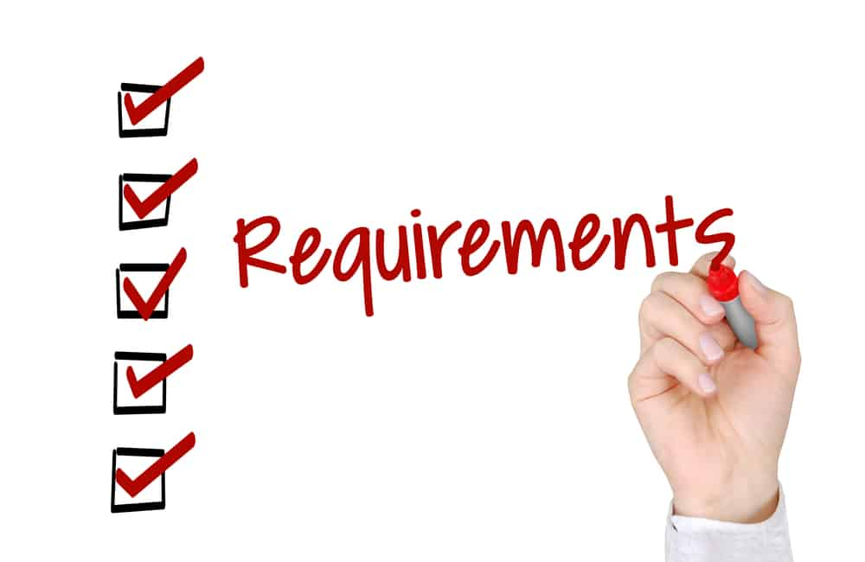
Detailed Requirements regarding Design
Camera placement
Image processing algorithms
Rule-based decision-making
Communication with the robots
Robustness and reliability
User interface
Data storage
2022 MSD AutoRef Project
Notes:
Camera placement: Capture all the action on the field, including the ball, players, and any potential rule violations.
Image processing algorithms: Sophisticated image processing algorithms that can analyze the camera footage in real-time, identify the location of the ball and players, and track their movements.
Rule-based decision-making: Identifying offside situations, fouls, and other rule violations.
Communication with the robots: The system should be able to communicate with the robots to signal any rule violations, such as stopping play when a foul is committed or indicating when a goal has been scored.
Robustness and reliability: Under different lighting conditions, weather conditions, and camera angles. It should also be able to handle any technical issues that may arise, such as camera malfunctions or communication failures.
User interface: The system should have a user interface that allows human referees to monitor the decisions made by the autonomous referee and intervene if necessary.
Data storage: The system should store all the camera footage and decisions made by the autonomous referee for analysis and review after the game.

